Slide 1


Python Programming Summer Camp
Class # 6
Libraries - Using Functions written by others
Files - Saving and Reading Data
By Asim Munawar

Slide 2

Course Plan
Lesson 1: Printing Fun – Say Hello to Python
Lesson 2: Variables – Remembering Things in Code
Lesson 2: If/Else – Making Decisions
Lesson 3: Loops – Doing Things Again and Again / Inputs
Lesson 4: Lists – Collecting Many Things
Lesson 5: Functions – Teach the Computer a New Trick
Lesson 6: Libraries - Using Functions written by others
Files – Saving and Reading Data
Lesson 7: Simple App with Gradio – Make Your Own Tool
Lesson 8: Final Project – Build and Present Your App

Slide 3


What is a Library?
A library is a collection of functions that can be shared with others.
Because they share their code for free.
It is called
open source.
Every Programmer knows the world is full of nice people. Why?

Slide 4
How to use a Library?
It is really simple:
“install” it
“import” it in the code
“call” the functions
import random
print(random.randint(1, 10))
from datetime import datetime
now = datetime.now()
print("Current date and time:", now.strftime("%Y-%m-%d %H:%M:%S"))

Slide 5



Artistic Print
Install Library
!pip install art
from art import tprint
tprint("Python")
Import a function from a library
Artistic print

Slide 6
Plots with Matplotlib
import matplotlib.pyplot as plt
# List of fruits and their "yumminess" score!
fruits = ["Apple", "Banana", "Grapes", "Mango"]
scores = [8, 9, 7, 10]
# Make a bar chart
plt.bar(fruits, scores, color="skyblue")
# Show the chart
plt.show()
Optional
# Add a title and labels
plt.title("My Favorite Fruits")
plt.xlabel("Fruit")
plt.ylabel("Yumminess Score (1–10)")

Slide 7
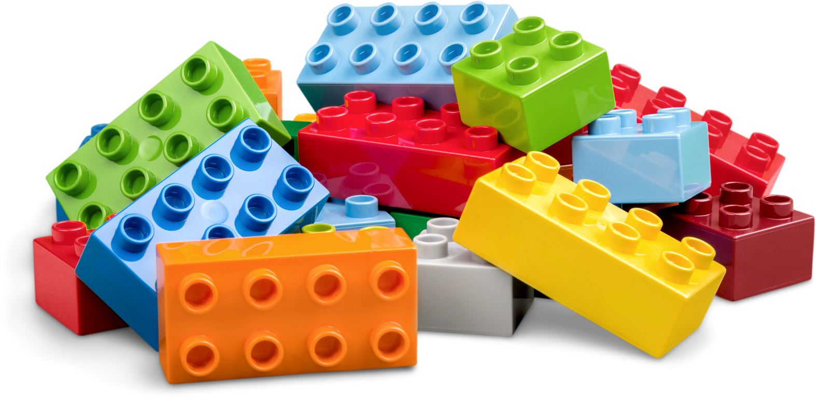
Fun Facts
Python Has Over 400,000 Libraries!
Superpower toolbox for anything — games, space science, AI, drawing, you name it!
Libraries Are Like LEGO Sets
You don’t build everything from scratch — just use the libraries to create something awesome!
NASA Uses Python Libraries
Yes! Python is used in space 🚀 — libraries like numpy and scipy help scientists run simulations.
Games Use Libraries Too
Libraries like pygame are used to build 2D games — the same tools professionals use!
You can even make your own library — it’s just a .py file with useful functions!

Slide 8
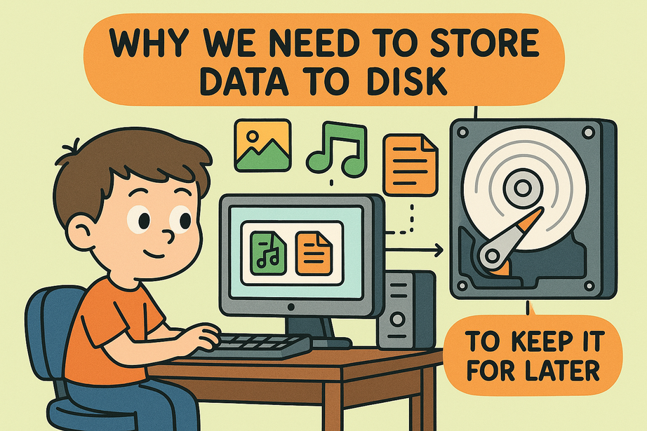
Save and Load Files
All the data is lost when we turn off the device.
If you want to store it, you need to save it in a file.
# 💾 Saving data to a file
with open("my_note.txt", "w") as file:
file.write("Hello! This is a saved message.\n")
file.write("Python is awesome!")
# 📂 Loading (reading) the saved file
with open("my_note.txt", "r") as file:
content = file.read()
print("File Content:")
print(content)

Slide 9
+, - , *, /
import random
score = 0
operators = ["+", "-", "*", "/"]
for i in range(10):
x = random.randint(1, 10)
y = random.randint(1, 10)
op = random.choice(operators)
# Avoid dividing by zero and force whole number division
if op == "/":
x = x * y # ensure x is divisible by y
question = f"What is {x} {op} {y}? "
user_answer = float(input(question))
# Evaluate the correct answer
if op == "+":
correct = x + y
elif op == "-":
correct = x - y
elif op == "*":
correct = x * y
elif op == "/":
correct = x / y
# Check answer
if abs(user_answer - correct) < 0.01:
print("✅ Correct!")
score += 1
else:
print(f"❌ Oops! The right answer is {correct}")
print(f"\n🎉 You got {score}/10 correct!")
Only Multiply
import random
score = 0
for i in range(10):
x = random.randint(1, 10)
y = random.randint(1, 10)
ans = int(input(f"{x} * {y} = "))
if ans == x * y:
print("Right!")
score += 1
else:
print("Wrong. Answer is", x * y)
print("Score:", score)
Random Math Questions

Slide 10
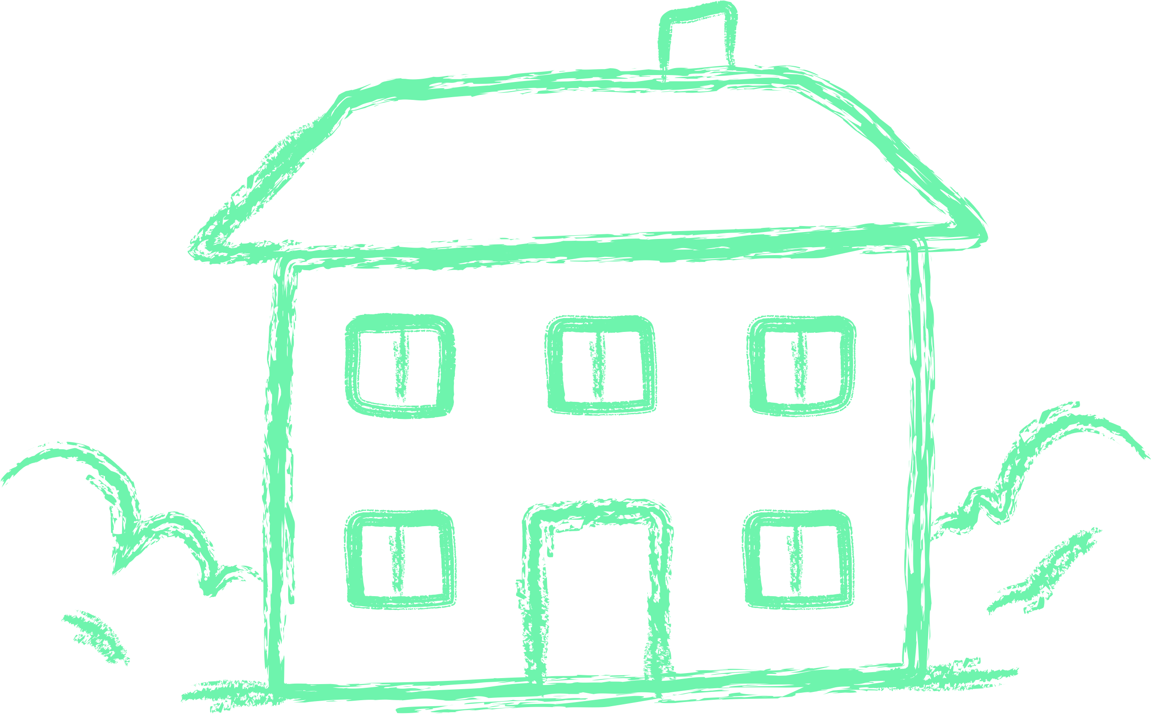
Homework
1. 🎲 Random Number Guess
Use the `random` library to pick a number between 1 and 10.
Ask the user to guess the number. Tell them if they’re right or wrong.
2. 📏 Square Root Calculator (Bonus)
Import the `math` library and write a function that takes a number and prints its square root.
3. 🎨 ASCII Art Name
Use the `art` library (pip install art) to print your name in fancy ASCII text.
4. 🎯 Save and Load File: My Secret Note
Write a program that asks the user to enter a secret message, then:
Saves the message in a file called secret.txt
Reads the message back from the file and prints it with
"Your secret message was: <message>"
5. ⏱ Countdown Timer
Import `time` and write a loop that counts down from 5 to 1, pausing 1 second between each.
🌟 Bonus Challenge: 📷 Image Magic
Use `cv2` (OpenCV) and `urllib` to load an image from the web and show a grayscale version of it using `matplotlib`.
(Hint: You can use the example shown in class!)

Slide 11


Thank You

